Slide 1
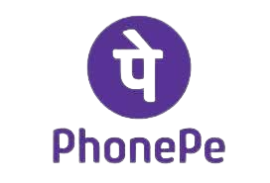
Phone Pe : Your Wallet in Your Pocket, Powering Seamless Transactions Everywhere.
Course: Innovation and Entreprenurship Name: Shreerang Mhatre Rollno: 52 Batch: A3 Class: TY School: B.Tech Electrical and Computer Enginnering

Slide 2
Introduction
PhonePe, a pioneering digital payments and financial technology company, emerged on the Indian scene in December 2015, co-founded by visionaries Sameer Nigam, Rahul Chari, and Burzin Engineer. With its headquarters nestled in Bengaluru, Karnataka, India, PhonePe swiftly made its mark in the dynamic landscape of financial services. The company's innovative journey reached a significant milestone in August 2016 when it unveiled its groundbreaking PhonePe app, leveraging the Unified Payments Interface (UPI). This technological marvel quickly became a game-changer, providing users with a seamless and secure platform for digital transactions, firmly establishing PhonePe as a key player in India's rapidly evolving digital economy. Today, PhonePe continues to redefine the contours of financial technology, consistently delivering cutting-edge solutions that empower users across the nation.

Slide 3
History
PhonePe was incorporated in December 2015. In April 2016, the company was acquired by Flipkart and as part of the acquisition, the FxMart license was transferred to PhonePe and rebranded as the PhonePe wallet. PhonePe's founder Sameer Nigam was appointed as the CEO of the company
In August 2016, the company partnered with Yes Bank to launch a UPr-based mobile payment app, based on government backed UPI platform.
Within three months of launch, the app was downloaded by over one crore users. In 2018, PhonePe became the fastest Indian payment app to aet a five crore badge on the Google Play Store. The PhonePe app overtook BHIM to become the market leader in UPI transactions in August 2017.

Slide 4
• To build a large, scalable & open transaction ecosystem that creates the maximum positive impact for all stakeholders. • PhonePe aims to create an open platform that will allow small and medium businesses to create a footprint in the digital space without the high customer acquisition cost.
Objectives

Slide 5
Buisness plan
PhonePe is authorized by RBI as the semi-closed wallet system. Whenever someone makes any type of transaction through PhonePe then PhonePe receives a fixed amount as a concision from the companies which are registered with PhonePe.
In addition to money transfers from one bank to another bank, Phonepe has turbulent features such as insurance, food, -gold, loan, purchase grocery through PhonPe, and many more. It has also offered diurnal services like mobile recharge, electricity bills, and other household bill payments. PhonePe is a kind of super app that provides all the features in one application. Those products are available in this app that provides a little discount.
PhonePe should Team up to form a Strategic Alliance with other parties in course of innovation. It is rightly doing so by creating an open platform for SMEs to create footprint in this space without high acquisition cost.

Slide 6
Revenue Model
The current revenue generation model of PhonePe is based on Commissions. The digital payment system is expanding exponentially with more number of people preferring digital payment systems over traditional methods. Also, there is high customer loyalty in this ecosystem. Hence the focus of the Digital wallets is currently on gaining market share through which they can collect the consumer data to analyze the buying behavior and patterns of their customers.
PhonePe can also partner with other websites that provide services like travel, leisure, ecommerce etc., For example, they can partner with ticket booking service providers like Ixiao where a majority of transactions are done through credit/debit cards. this will enable PhonePe to generate revenue by replacing the dominant methods of transactions.

Slide 7
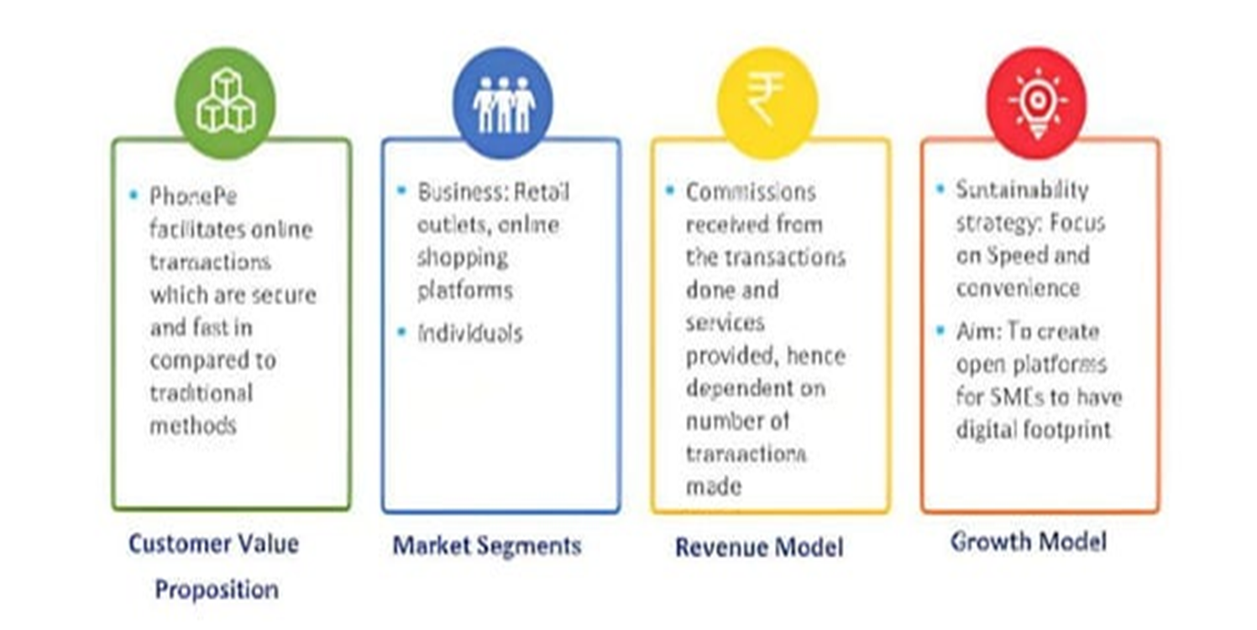
Utility

Slide 8
• PhonePe uses 30 technology products and services including HTMLS, jQuery, and Google Analytics, according to G2 Stack. • PhonePe is actively using 63 technologies for its website, according to BuiltWith. These include Viewport Meta, IPhone / Mobile Compatible, and SPF.
Technology used

Slide 9
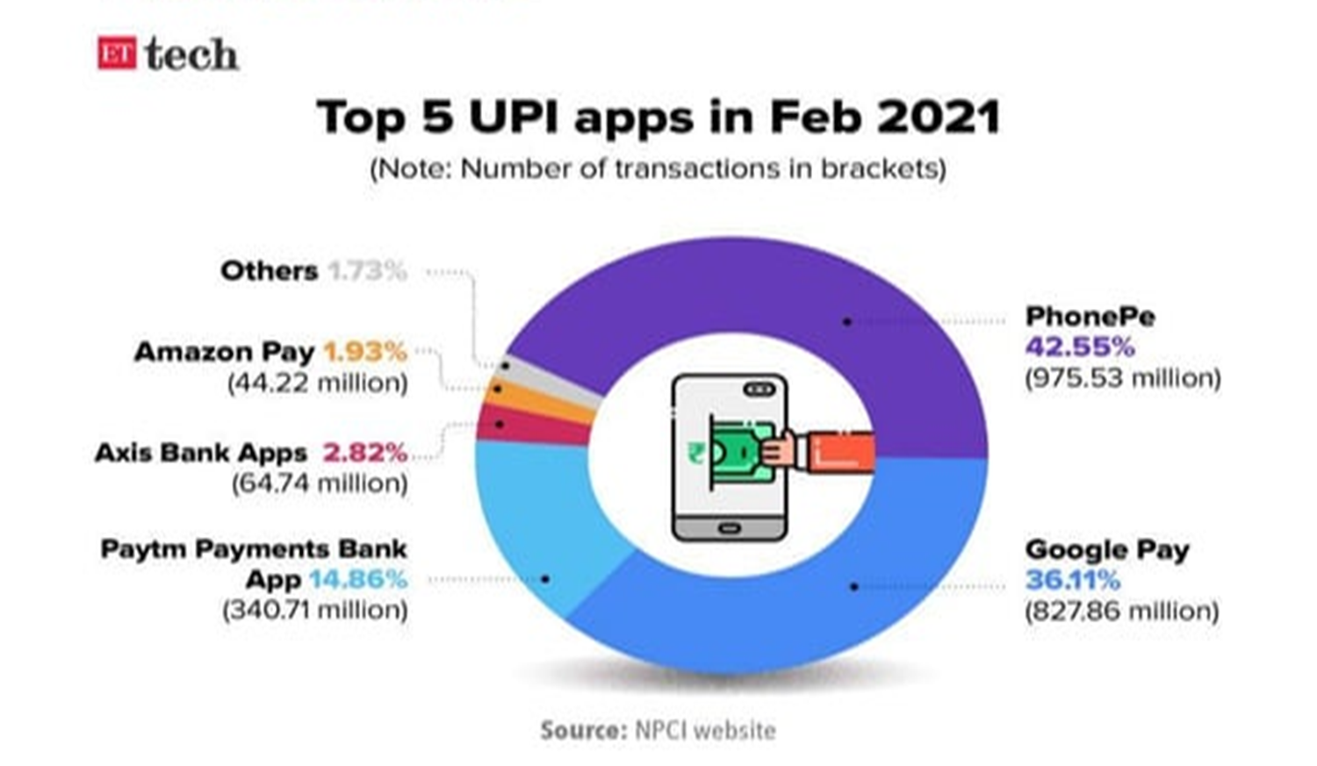
Market Share

Slide 10
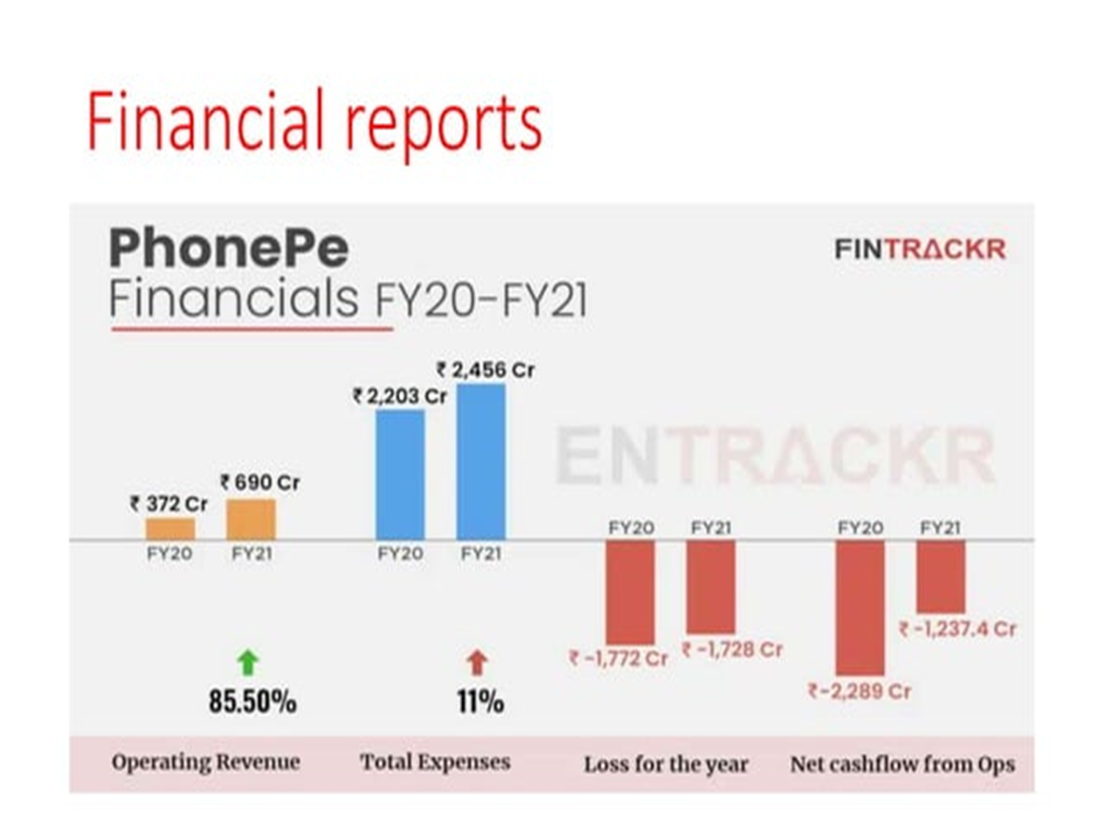
Financial Reports

Slide 11
SWOT Analysis
Strengths
Weakness
Opportunities
Threats
PhonePe, recognized as an authorized entity by the Reserve Bank of India (RBI), operates as a registered partial payment system
With a steadfast commitment to user security, PhonePe ensures a safe digital environment for financial transactions
Phishing - Fraudsters send fake emails/messages etc. hoping users will part with personal information.
Social Engineering - Fraudsters give incorrect details on websites/apps, intercept calls/emails and steal the customer's personal information.
KYC fraud - Fraudsters send users messages about their KYC expiring and try to get their personal details.
Untapped marketing platform.
Expansion into global market can boost business.
Growth in interest of Indians towards fashion and lifestyle.
Global competitors like amazon slowly making its foray. • Economic fluctuation and unfavorable government policies.
Relationship with third party logistics company

Slide 12
PhonePe is enjoying a monopoly with a market share of and provides safe and secure online transactions. PhonePe facilitates services, payments, and online transactions for several products available on the PhonePe application, website, or any other third-party merchant storefronts (online or offline) : PhonePe also provides wallet services just like Paytm and Amazon pay.
CONCLUSION

Slide 13
Thankyou

